Slide 1
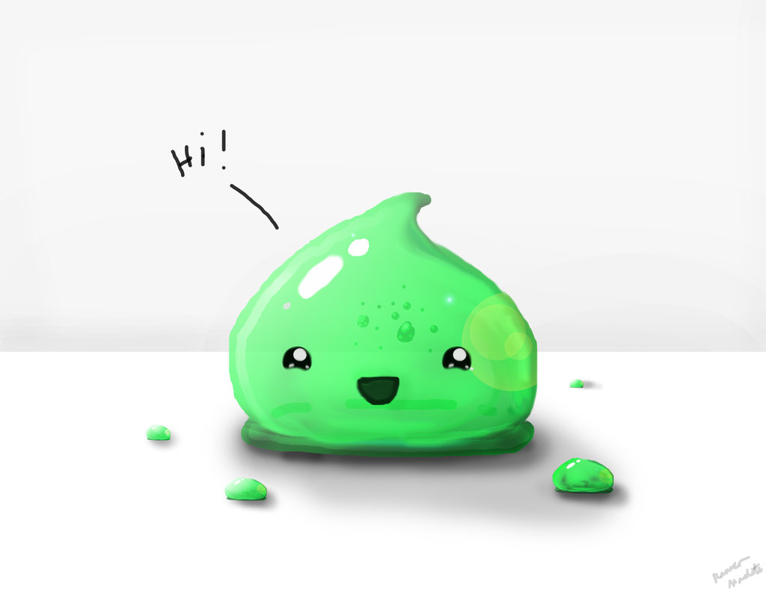
Kingdom Clean-Up
Notes:
Introduce ourselves

Slide 2
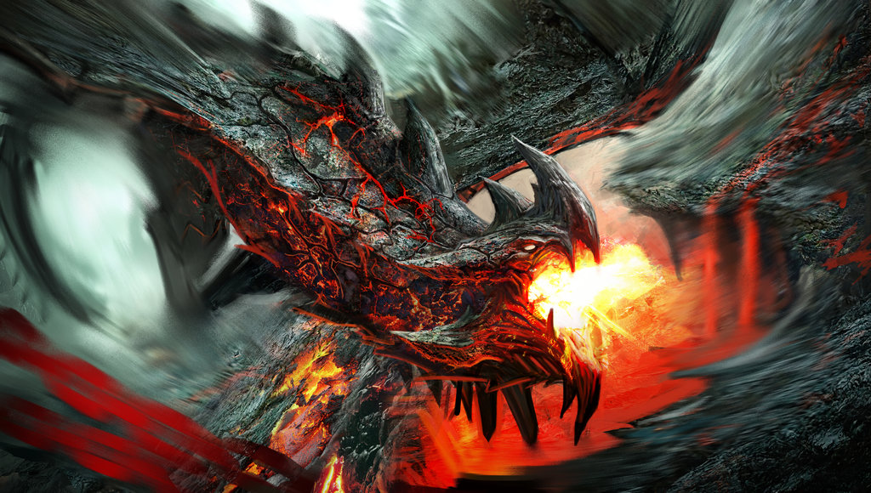
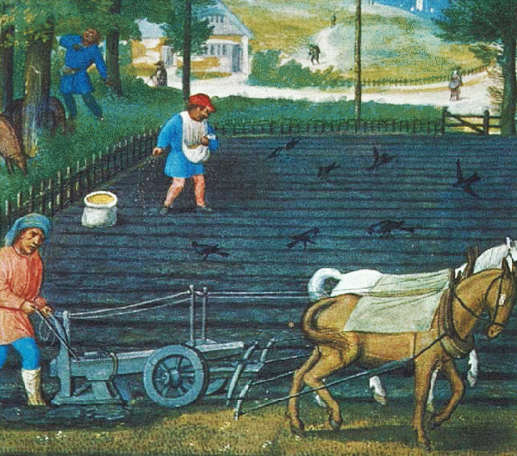
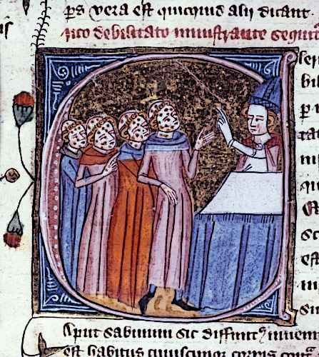
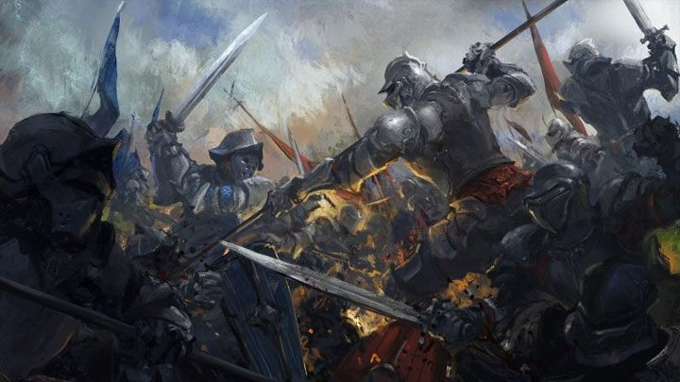
Notes:
Your kingdom has survived war, famine, disease, and even dragons, but after everything it has overcome, the kingdom has finally fallen…to the slimes? It is now up to you to take your kingdom back and restore its glory, even if you are just the cleaner.

Slide 3
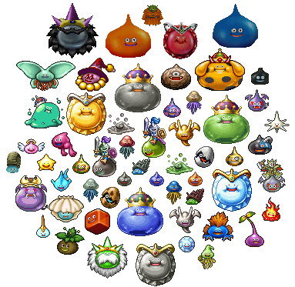
Notes:
Your kingdom has survived war, disease, natural disasters, and even dragons, but after everything it has overcome, the kingdom has finally fallen…t-to the slimes? It is now up to you to take your kingdom back and restore its glory, even if you are just the cleaner.

Slide 4
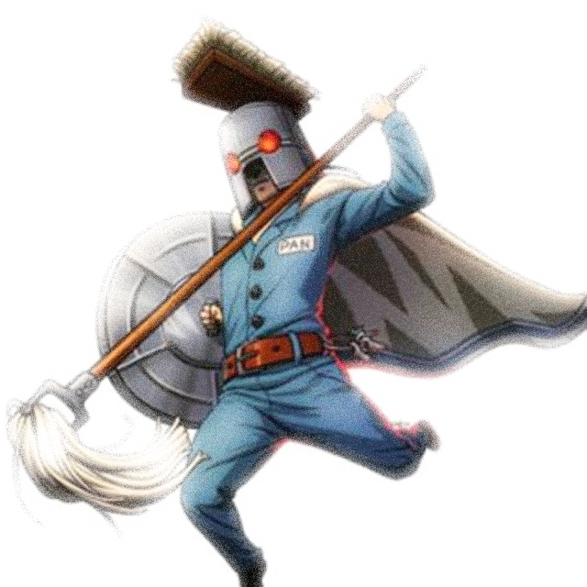

Slide 5
Core Experience
Become the unlikely hero as you “clean-up” each stage as the kingdom’s cleaner.

Slide 6
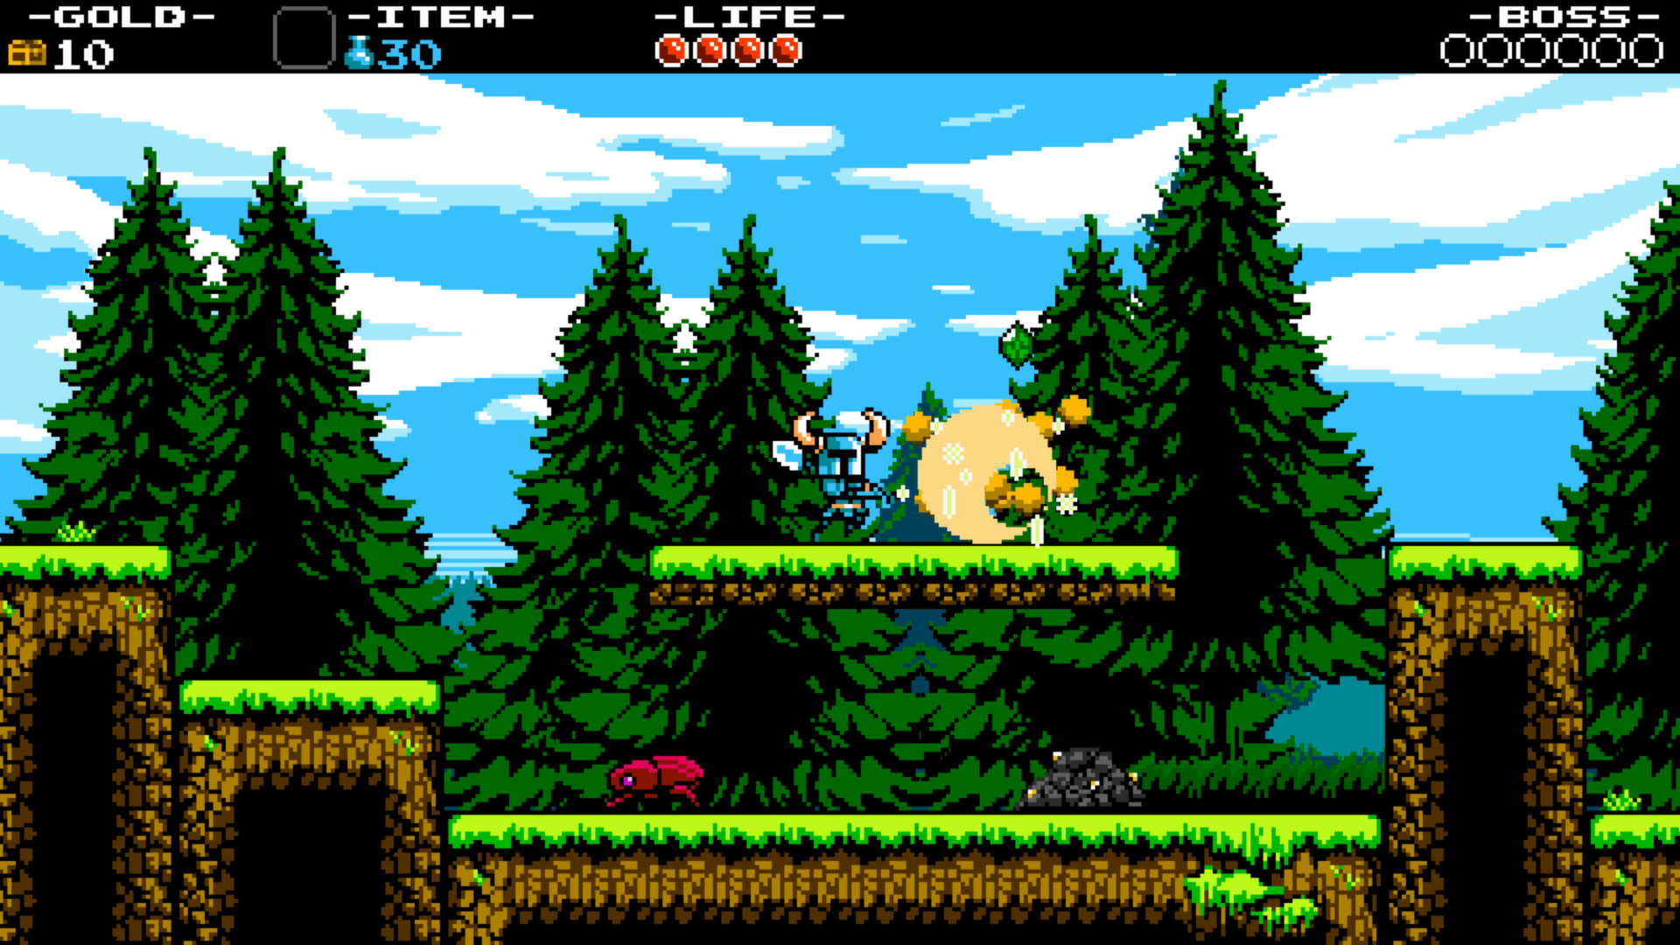
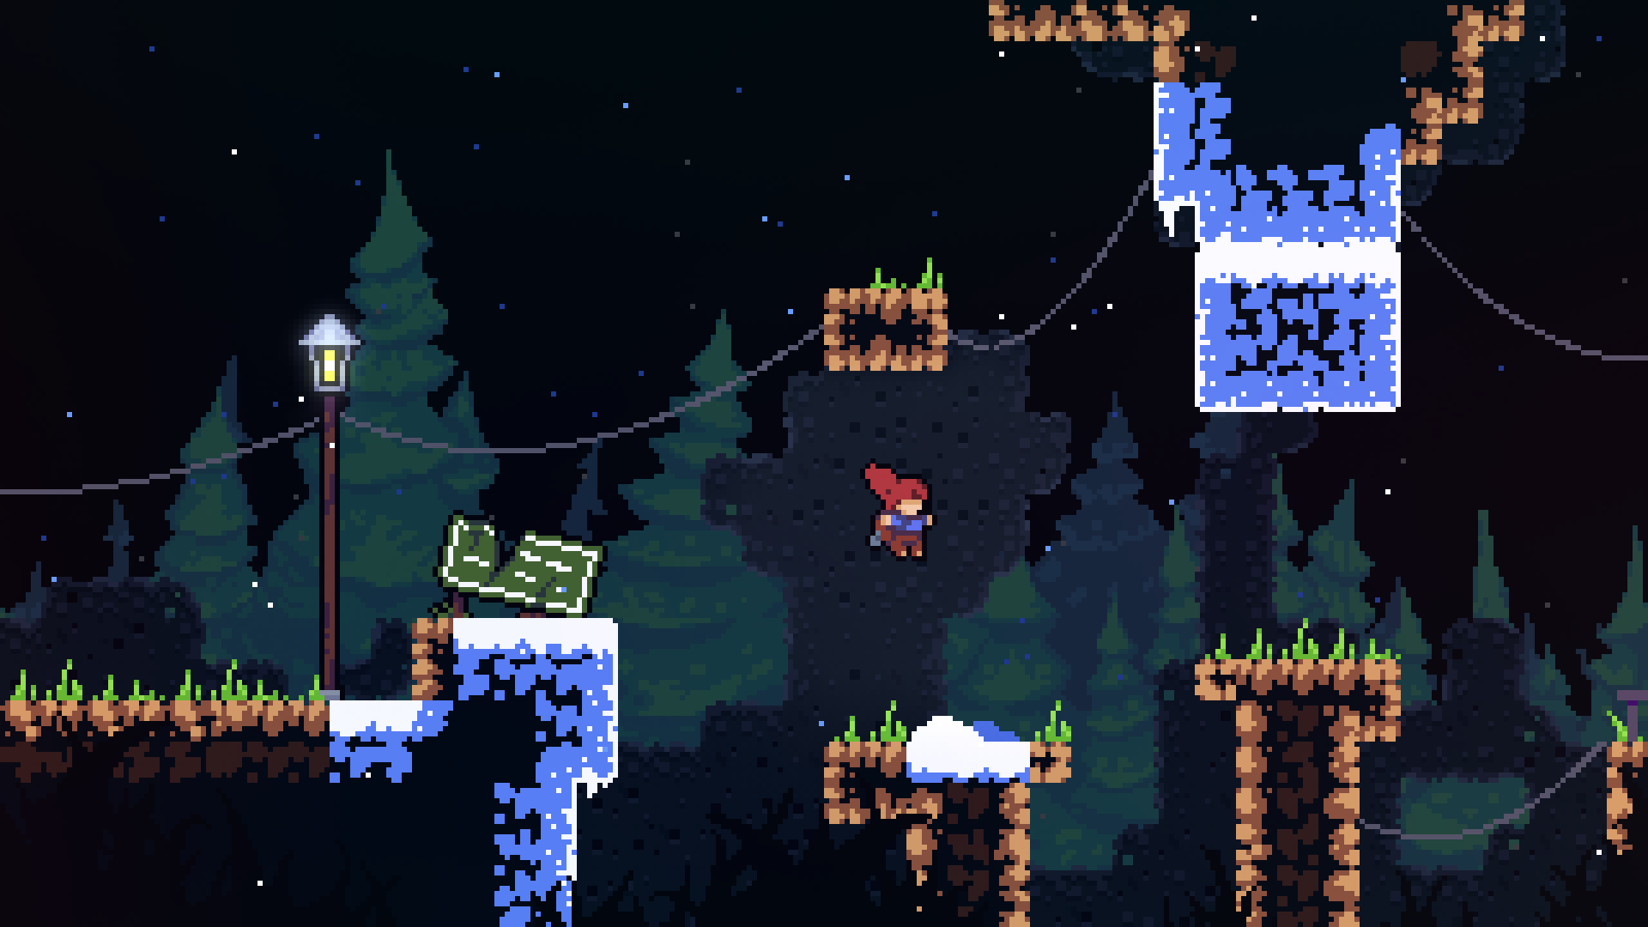
Genre
2D Action Adventure

Slide 7
Ideas for Gameplay
Clean up a certain amount of the stage
Stages emphasize a special slime type
Use that slime to defeat the boss of the stage
Fallen Kingdom, you are an unusual savior

Slide 8

Mechanics
Clean
Clean up
Re-use
Slime Effects
High Bounce
Wall Jump
Slide

Slide 9
Design Challenges
Cleaning Mechanic – Simple and satisfying.
Level Design – Emphasize the cleaning mechanic
Unique Items – no ones wants to use a mop
Enemy Design – Interaction with the cleaning mechanic/ Challenging

Slide 10
Design Pillars
Cleaning Mechanic – Viewing similar games and principles
Level Design – Prototyping
Unique Items – Cleaning Supplies/Traditional Game Items (mop as a sword?)
Enemy Design – Enemy Splitting? Swarm?

Slide 11


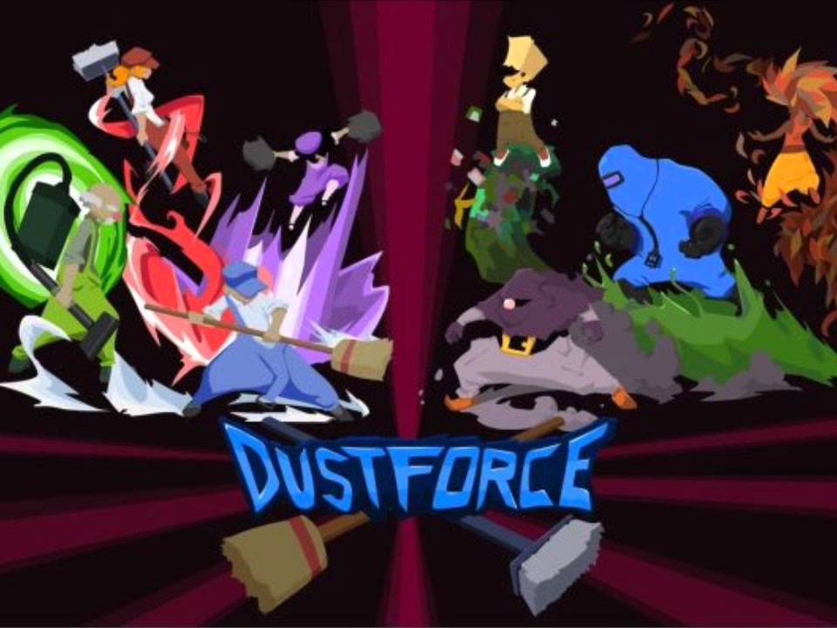
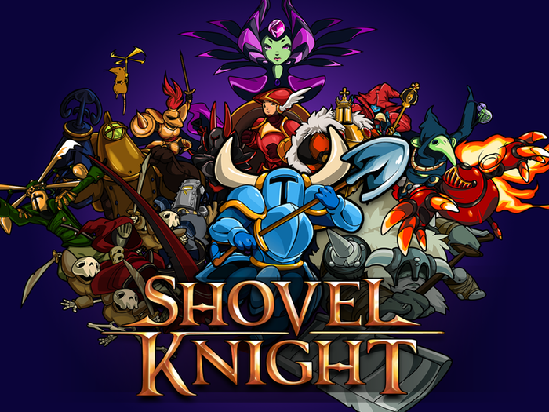
Games to look at

Slide 12
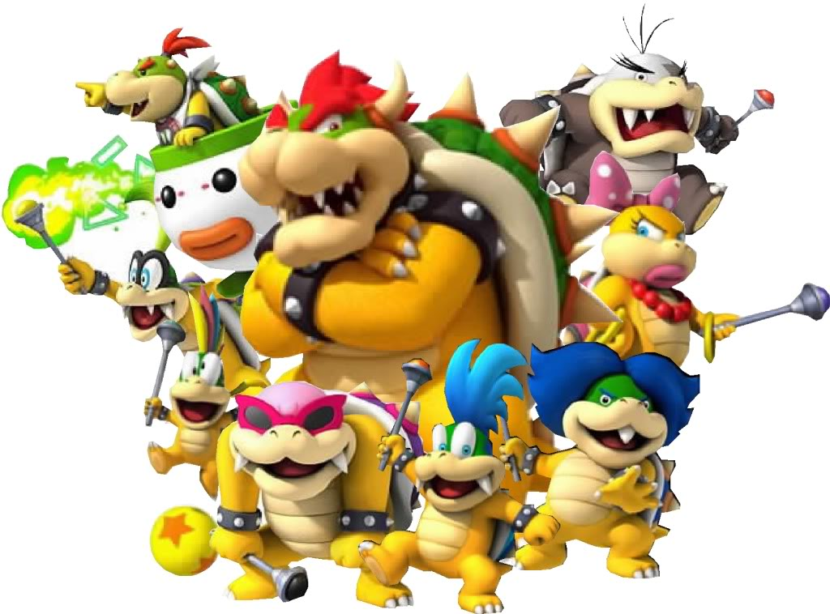
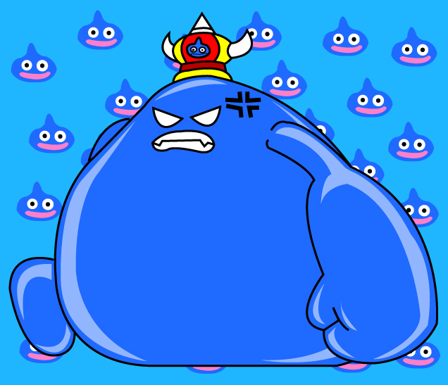
Conventions
Breaking - Slimes are weak and useless.
Keeping – Traditional Action Adventure vibe/ Bosses and Mini-Bosses.

Slide 13
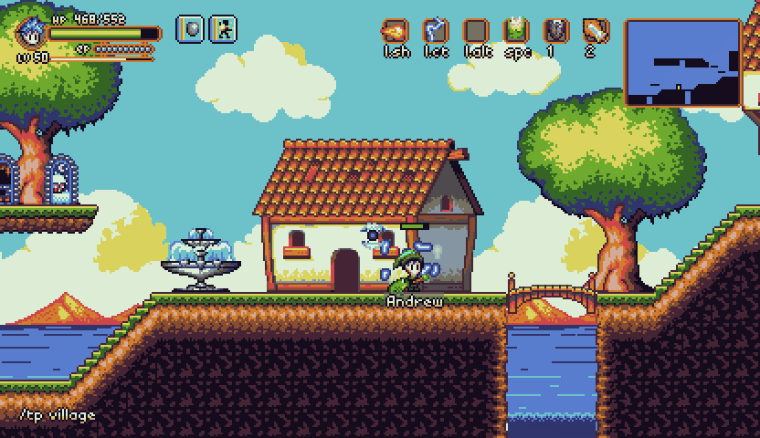

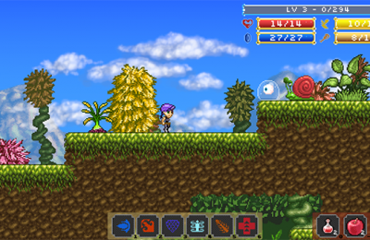

Aesthetics
Music
Retro
8-Bit
Art
Colorful
Pixelated

Slide 14



Technology
Unity – Easy asset imports
Controller – Easy to use, Easy to implement
OrgMaker – 8bit Music Maker

Slide 15
Unique Features
Environmental Effects through use of slimes.
Wide variety of items
Mop
Towel
Squeegee

Slide 16
What we have and what we need
Lead Designer – Dillon Johnson
Project Manager – Rachel Groth
Art – Two
Coding – One more
Narrative – One more
Audio – One

Slide 17
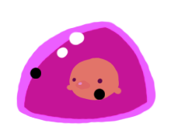

Questions?

